Slide 1
Overview of Memory Management
Course: Operating Systems
Instructor: AWOTUNDE J. B.
Date: 27Th October 2025

Slide 2
Lecture Objectives
• Explain why several processes must be kept in memory.
• Describe the activities performed by the OS in memory management.
Notes:
Introduce the learning outcomes to students and connect them to broader OS memory handling concepts.

Slide 3
Introduction to Memory Management
Memory is large array of words or bytes, each having its unique address.
CPU fetches instructions from memory according to value of program counter.
The instructions undergo instruction execution cycle.
To increase both CPU utilization and speed of its response to users, computers must keep several processes in memory.
Notes:
Discuss how memory management underpins multitasking and system efficiency.

Slide 4
Memory management is the functionality of an operating system which handles or manages primary memory and moves processes back and forth between main memory and disk during execution.
Memory management keeps track of each and every memory location, regardless of either it is allocated to some process or it is free.
It checks how much memory is to be allocated to processes.
It decides which process will get memory at what time.
It tracks whenever some memory gets freed or unallocated and correspondingly it updates the status
Notes:
Discuss how memory management underpins multitasking and system efficiency.

Slide 5
Specifically, the memory management modules are concerned with following four functions:
1. Keeping track of whether each location is allocated or unallocated, to which process and how much.
2. Deciding to whom the memory is allocated, how much, when and where.
If memory is to be shared by more than one process concurrently, it must be determined which process’ request should be satisfied.
Notes:
Discuss how memory management underpins multitasking and system efficiency.

Slide 6
3. Once it is decided to allocate memory, the specific locations must be selected and allocated.
Memory status information is updated.
4. Handling the deallocation/reallocation of memory.
After the process holding memory is finished, memory locations held by it are declared free by changing the status information.
Notes:
Discuss how memory management underpins multitasking and system efficiency.

Slide 7
Why Keep Several Processes in Memory
• Improves CPU utilization.
• Enables multiprogramming.
• Supports communication and virtual memory.
Notes:
Explain that modern OSs rely on concurrency; multiple processes prevent idle CPU time.

Slide 8
Modern operating systems rely heavily on concurrency — the ability to execute multiple processes or threads seemingly at the same time.
This design ensures that the CPU is kept busy and productive instead of sitting idle while waiting for slower operations, such as input/output (I/O) or memory access, to complete.
Notes:
Discuss how memory management underpins multitasking and system efficiency.

Slide 9
When one process is waiting for an event (for example, reading data from a disk), the operating system can switch to another ready process, keeping the CPU active.
This overlapping of computation and I/O allows better utilization of system resources, faster response times, and improved overall performance.
Notes:
Discuss how memory management underpins multitasking and system efficiency.

Slide 10
In essence, concurrency helps the OS to:
Maximize CPU utilization by filling idle gaps.
Support multitasking, allowing multiple applications to run smoothly.
Enhance system responsiveness for users and background tasks.
Thus, without concurrency and multiple processes, modern systems would waste valuable CPU cycles during waiting periods, leading to poor efficiency and slower performance.
Notes:
Discuss how memory management underpins multitasking and system efficiency.

Slide 11
Logical Address
A logical address (also called a virtual address) is the address generated by the CPU when a program is running.
Where it exists: In the user’s view (program’s perspective).
Each running process believes it has its own continuous block of memory.
Who generates it: The CPU, during program execution.
Purpose: It allows programs to be independent of physical memory — meaning they don’t need to know where their data actually sits in RAM.
Example:
If a program accesses memory location 1000, that’s a logical address.
But this 1000 might not correspond to the same physical address in RAM.
Notes:
Discuss how memory management underpins multitasking and system efficiency.

Slide 12
Physical Address
The physical address is the actual location in the computer’s RAM (main memory).
Where it exists: In the hardware’s view (memory chips).
It’s the address that the memory unit (RAM) uses to store or fetch data.
Who uses it: The Memory Unit, it only understands physical addresses.
Relation to logical address: A logical address must be translated to a physical address before the data can be accessed.
Example:
The logical address 1000 (from CPU) may correspond to physical address 5000 in RAM.
Notes:
Discuss how memory management underpins multitasking and system efficiency.

Slide 13
MMU (Memory Management Unit)
The MMU is a hardware component that automatically translates logical addresses to physical addresses.
Function: It sits between the CPU and the physical memory, performing address mapping in real time.
Controlled by: The Operating System, which provides the mapping tables (like page tables in virtual memory).
Importance: This translation allows:
  Memory protection: Each process accesses only its own memory.
  Efficient memory use: Enables features like paging and segmentation.
  Process isolation: Prevents one program from interfering with another.
Example Workflow:
CPU generates a logical address → 1000
MMU checks its mapping table and translates it to physical address → 5000
Data is fetched from physical memory location 5000.
Notes:
Discuss how memory management underpins multitasking and system efficiency.

Slide 14
Concept | Description | Generated/Used by | Example Address | Role
Logical Address | Address generated by the CPU during execution | CPU | 1000 | Used by programs
Physical Address | Actual location in main memory (RAM) | Memory hardware | 5000 | Used by RAM
MMU | Hardware that translates logical → physical | CPU & OS | 1000 → 5000 | Provides mapping & protection
Notes:
Highlight advantages for modular programs and compiler design.

Slide 15
OS Activities in Memory Management
• Tracking memory usage.
• Allocation and protection.
• Sharing and mapping.
• Swapping, paging, segmentation.
Notes:
Outline OS responsibilities; emphasize protection and efficiency.

Slide 16
Binding of Instructions and Data to Memory:
The binding of data and program to memory address can be done at any of the following steps:
Compile Time: Binding at compile time generates absolute addresses where a prior knowledge is required that where a process resides in the memory. After sometime if the starting location of a process in memory is changed, then the entire process must be recompiled to generate the absolute address again.
Load Time: at compile time if it is not known that where a process will reside in memory then the compiler must generate relocatable address. In this case, final binding is delayed until load time. If the starting address is changed then we need only to reload the user code to incorporate this changed value.
Execution Time: this method permits moving a process from one memory segment to another during rum time. In this case, final binding is delayed until run time.
Notes:
Use diagram to explain page/frame mapping; discuss simplicity of paging.

Slide 17
Memory Management Techniques
There are two Memory Management Techniques: Contiguous, and Non-Contiguous.
In Contiguous Technique, executing process must be loaded entirely in main-memory.
In contiguous memory allocation each process is contained in a single contiguous block of memory.
Memory is divided into several fixed size partitions. Each partition contains exactly one process.
Contiguous Technique can be divided into:
Fixed (or static) partitioning
Variable (or dynamic) partitioning
Notes:
Relate to page file in Windows and swap space in Linux.

Slide 18
Fixed Partitioning:
This is the oldest and simplest technique used to put more than one processes in the main memory.
In this partitioning, number of partitions (non-overlapping) in RAM are fixed but size of each partition may or may not be same.
As it is contiguous allocation, hence no spanning is allowed.
Here partitions are made before execution or during system configure.
Notes:
Relate to page file in Windows and swap space in Linux.

Slide 19
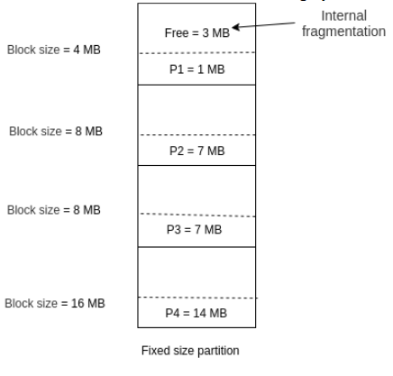
Notes:
Illustrate how fragmentation wastes space; connect to paging as a solution.

Slide 20
Advantages of Fixed Partitioning
Easy to implement:
Little OS overhead:
Disadvantages of Fixed Partitioning
Internal Fragmentation
External Fragmentation
Limit process size
Limitation on Degree of Multiprogramming
Notes:
Relate to page file in Windows and swap space in Linux.

Slide 21
Variable Partitioning
It is a part of Contiguous allocation technique.
It is used to alleviate the problem faced by Fixed Partitioning.
In contrast with fixed partitioning, partitions are not made before the execution or during system configure
Notes:
Relate to page file in Windows and swap space in Linux.

Slide 22
Various features associated with variable Partitioning
Initially RAM is empty and partitions are made during the run-time according to process’s need instead of partitioning during system configure.
The size of partition will be equal to incoming process.
The partition size varies according to the need of the process so that the internal fragmentation can be avoided to ensure efficient utilisation of RAM.
Number of partitions in RAM is not fixed and depends on the number of incoming process and Main Memory’s size.
Notes:
Relate to page file in Windows and swap space in Linux.

Slide 23
Advantages of Variable Partitioning
1. No Internal Fragmentation
2. No restriction on Degree of Multiprogramming
3. No Limitation on the size of the process
Notes:
Relate to page file in Windows and swap space in Linux.

Slide 24
Disadvantages of Variable Partitioning
1. Difficult Implementation
2. External Fragmentation
Notes:
Relate to page file in Windows and swap space in Linux.

Slide 25
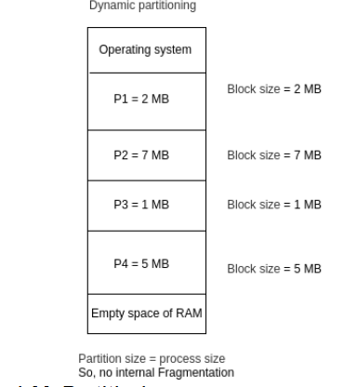
Notes:
Illustrate how fragmentation wastes space; connect to paging as a solution.

Slide 26
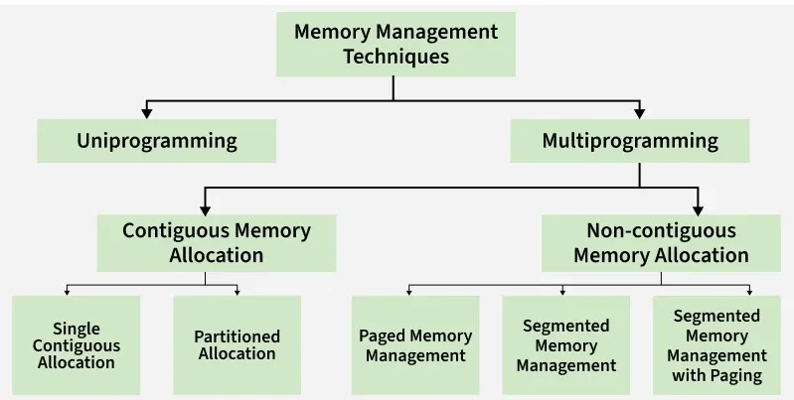
Notes:
Illustrate how fragmentation wastes space; connect to paging as a solution.

